Slide 1

Controlling Volume with Hand Gestures
Using a Webcam by : Dhanush.m mentor : Dr. D.Bhanu Prakash

Slide 2
Gesture Recognition and Distance Measurement
  Core Code Snippets Used for Hand Landmark Detection
1. Importing Libraries:
import cv2, mediapipe as mp, numpy as np,
pandas as pd,matplotlib.pyplot as plt
Loads all essential libraries for video capture, landmark detection, data handling, and visualization.
2. Initializing MediaPipe Hands:
mp_hands = mp.solutions.hands
mp_drawing = mp.solutions.drawing_utils
hands = mp_hands.Hands(
static_image_mode=False,
model_complexity=1,
min_detection_confidence=0.75,
min_tracking_confidence=0.75 )
Sets up the hand detection model with confidence thresholds and tracking enabled.
Detects up to 2 hands and tracks 21 key landmarks per hand.
3. Capturing Frame from Webcam:
cap = cv2.VideoCapture(0, cv2.CAP_DSHOW) ret, frame = cap.read(); cap.release()
frame = cv2.flip(frame, 1)
frame_rgb = cv2.cvtColor(frame,
cv2.COLOR_BGR2RGB)
Captures a live webcam frame, flips it for a mirror view, and converts it to RGB (required by MediaPipe).
4. Processing the frame:
results = hands.process(frame_rgb)
if results.multi_hand_landmarks:
hand_landmarks=results.multi_hand_landmarks[0]
Sends the captured frame to the MediaPipe model to detect and extract landmarks.

Slide 3
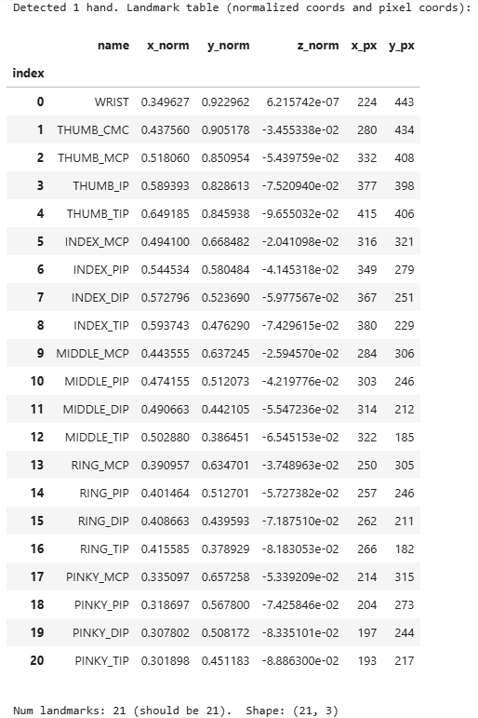
Gesture Recognition and Distance Measurement
  Generating the Landmark Table & Annotated Output
1. Creating a Landmark table:
rows = []
for idx, lm inenumerate(hand_landmarks.landmark):
x_px = int(lm.x * img_w)
y_px = int(lm.y * img_h)
rows.append([idx, lm.x, lm.y, lm.z, x_px, y_px])
df = pd.DataFrame(rows, columns=["Index”,
"x_norm", "y_norm", "z_norm", "x_px", "y_px"])
display(df)
Converts normalized coordinates (0–1 range) to pixel coordinates.
Displays all 21 landmarks in a clean pandas DataFrame.Loads all essential libraries for video capture, landmark
Output 1:

Slide 4
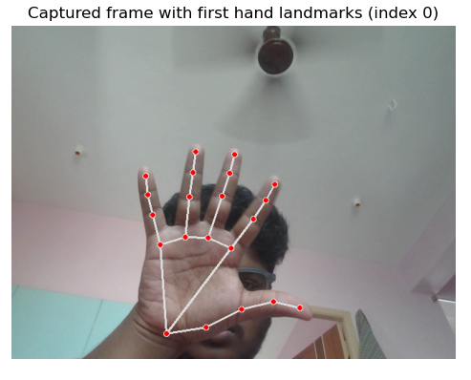
Gesture Recognition and Distance Measurement
  Generating the Landmark Table & Annotated Output
2. Drawing Landmarks:
annotated = frame.copy()
mp_drawing.draw_landmarks(annotated,
hand_landmarks, mp_hands.HAND_CONNECTIONS)
plt.imshow(cv2.cvtColor(annotated,
cv2.COLOR_BGR2RGB))
plt.axis("off")
plt.title("Captured frame with hand landmarks")
plt.show()
Draws connections & points between landmarks.
Displays the final annotated hand image.
Output 2:

Slide 5
Gesture Recognition and Distance Measurement
  Real-time Thumb↔Index Distance
1. Distance Calculation:
lm_thumb = hand.landmark[4]; lm_index = hand.landmark[8] norm=math.dist([lm_thumb.x,lm_thumb.y,lm_thumb.z],[lm_index.x,lm_index.y,lm_index.z])
pix = math.hypot((lm_thumb.x-lm_index.x)*w,
(lm_thumb.y-lm_index.y)*h)
Calculates thumb–index distance in normalized & pixel units.
2. Pinch Detection & Visualization:
pinch = (pix<=40 or norm<=0.03)
cv2.circle(frame,(tx,ty),8,(0,0,255),-1)
cv2.circle(frame,(ix,iy),8,(255,0,0),-1)
cv2.line(frame,(tx,ty),(ix,iy),(0,255,0),2)
Detects pinch gesture and draws colored dots + line on the frame.
3. Live Plot & Logging:
timestamps.append(t); norm_d.append(norm); pix_d.append(pix) line_norm.set_data(timestamps,norm_d); line_pix.set_data(timestamps,pix_d)
Updates real-time plot and optionally logs data to CSV.

Slide 6
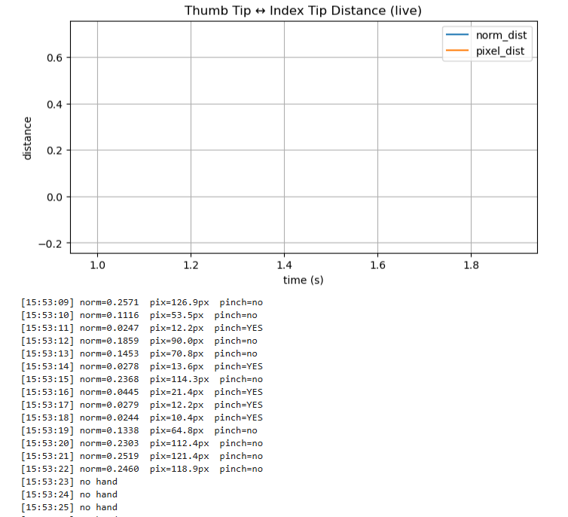
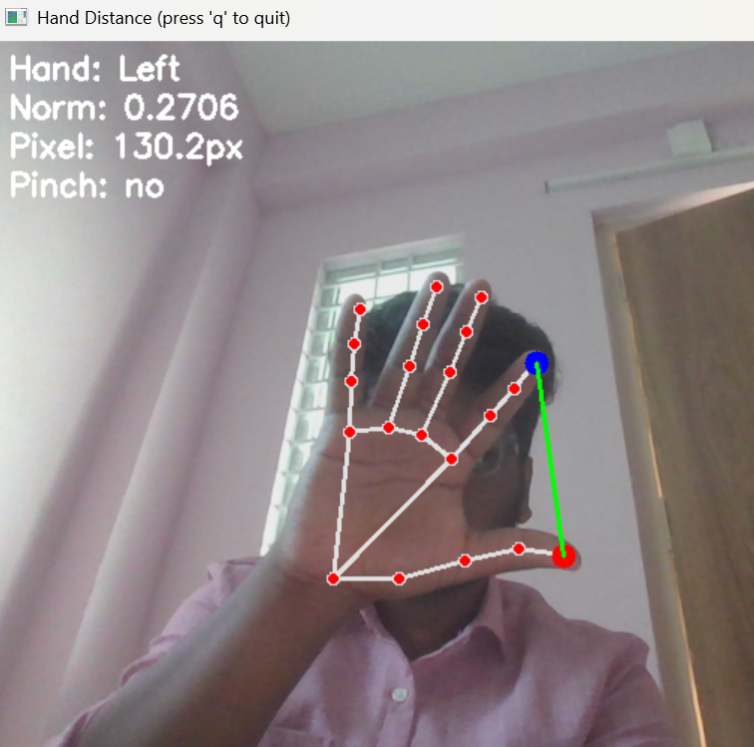
Gesture Recognition and Distance Measurement
  From Code → Outputs
1. Live Graph Output:
Plots Thumb ↔ Index distance over time(normalized + pixel)
Auto-updates using matplotlib for continuous tracking.
2. Webcam Frame Output:
Red = Thumb Tip, Blue = Index Tip, Green = distance line.
Text overlay: Hand, Norm, Pixel, Pinch.

Slide 7
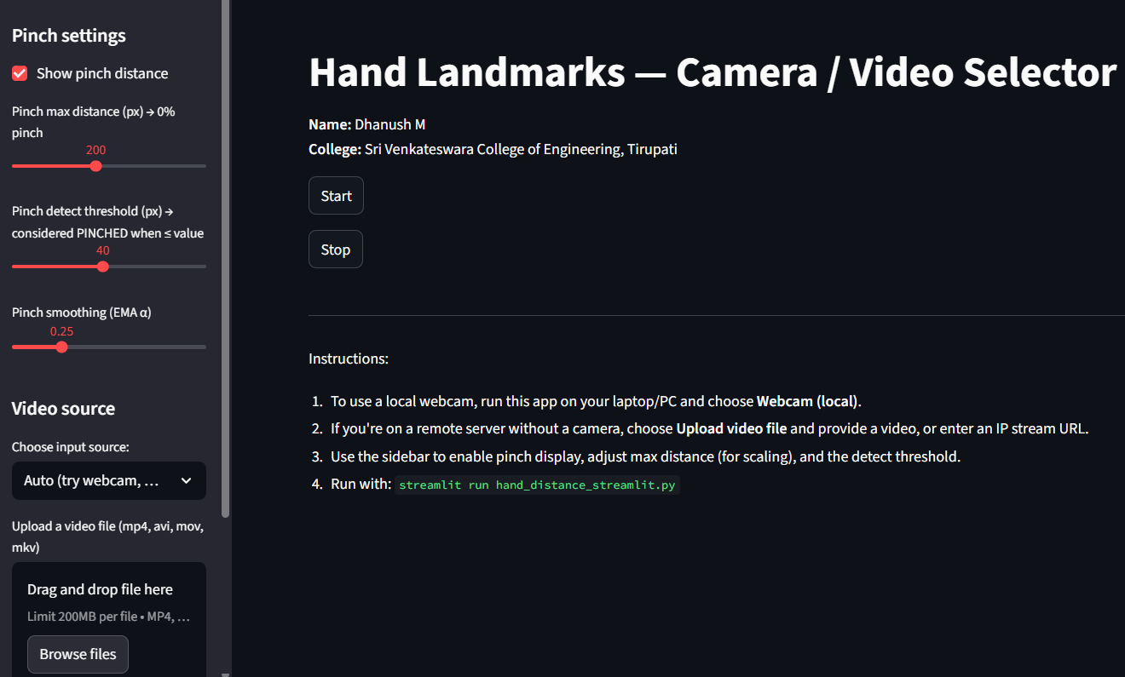
Gesture Recognition and Distance Measurement
  Hand Landmarks — Camera / Video Selector (Streamlit App)
1. Purpose:
Web-based app for hand tracking & pinch detection
Built using Streamlit + MediaPipe + OpenCV
Supports Webcam, Video Upload, or IP Stream
Main Code Snippets:
enable_pinch = st.sidebar.checkbox("Show pinch distance", value=True)
pinch_max_dist = st.sidebar.slider("Pinch max
distance",50, 400, 200)
hands=mp.solutions.hands.Hands(max_num_hands=2)
if st.button("Start"): st.session_state.running = True
Adds sidebar controls, initializes MediaPipe Hands, and starts live detection.

Slide 8
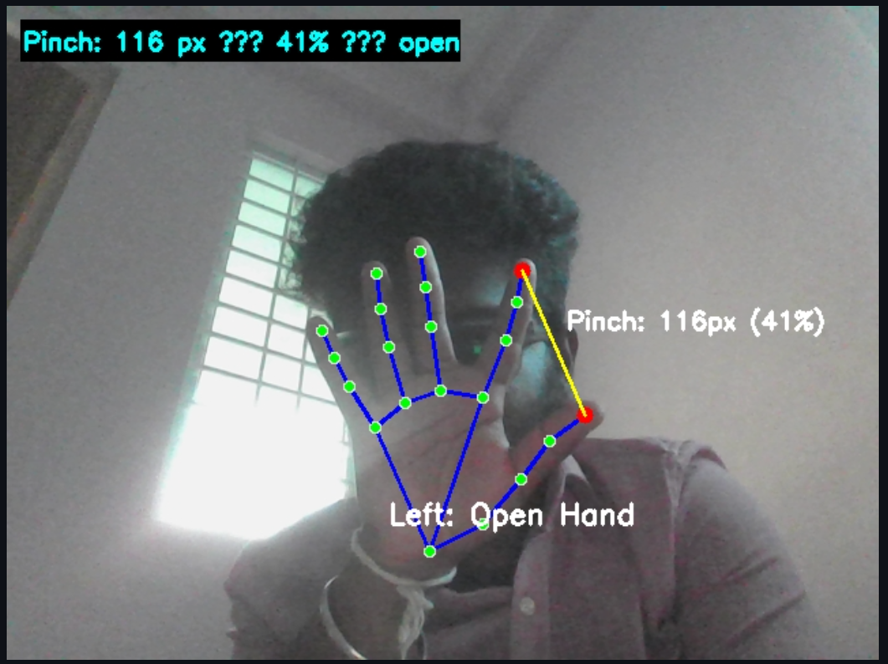
Gesture Recognition and Distance Measurement
  Pinch Detection Visualization & Results
1. Pinch Detection Logic:
lm4, lm8 = hand[4], hand[8]
distance = np.hypot(x8 - x4, y8 - y4)
is_pinched = distance <= pinch_detect_threshold
Calculates thumb–index distance & checks pinch condition.
2. Output:
Red/Blue Dots: Thumb & Index tips
Yellow Line: Pinch distance
Text Overlay: e.g. Pinch: 116px (41%) open
3.Features:
Real-time gesture & pinch detection
Adjustable thresholds via sliders
Works on webcam, video, or IP stream

Slide 9
Thank you

